Slide 1
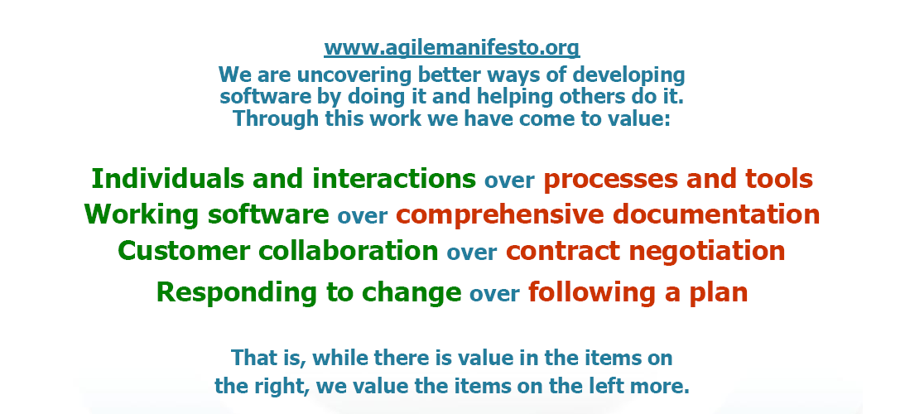
Agile Manifesto (2001)
http://agilemanifesto.org/
Notes:
1
1
Speakers notes:
Background:
17 people met at the ”The Lodge” in Snowbird, a ski resort in the Wasatch mountains in, Utah, February 2001. Representatives for XP, (eXtremeProgramming) Scrum, Adaptive Software Development, Crystal, Feature-Driven Development (to mention some of the representatives). The group founded the Agile Manifesto and the Agile Principles at his occasion.
Something worth considering:
It is clear that no matter the well defined processes and advanced tools made available for a team; if the persons in the team can not cooperate the processes and tools doesn't make a difference. It is more important to secure that the Team can work together as persons to get efficiency, speed and quality.
A typical user of a system will approve better with a well functioning SW rather than a complex manual or specification. The main goal is to develop products, not necessarily develop documentation.
Reduce the risk for misunderstandings by communicate changes early rather than wait for the requirement specification.
Course Documentation Ericsson R&D Agile & Lean Basics

Slide 2
Principles behind the Agile Manifesto
Our highest priority is to satisfy the customer through early and continuous delivery of valuable software.
Welcome changing requirements, even late in development. Agile processes harness change for the customer's competitive advantage.
Deliver working software frequently, from a couple of weeks to a couple of months, with a preference to the shorter timescale.
Business people and developers must work together daily throughout the project.
Build projects around motivated individuals. Give them the environment and support they need, and trust them to get the job done.
The most efficient and effective method of conveying information to and within a development team is face-to-face conversation.
Notes:
2
2
Speakers notes:
Background:
17 people met at the ”The Lodge” in Snowbird, a ski resort in the Wasatch mountains in, Utah, February 2001. Representatives for XP, (eXtremeProgramming) Scrum, Adaptive Software Development, Crystal, Feature-Driven Development (to mention some of the representatives). The group founded the Agile Manifesto and the Agile Principles at his occasion.
Course Documentation Ericsson R&D Agile & Lean Basics

Slide 3
Principles behind the Agile Manifesto
Working software is the primary measure of progress.
Agile processes promote sustainable development. The sponsors, developers, and users should be able to maintain a constant pace indefinitely.
Continuous attention to technical excellence and good design enhances agility.
Simplicity--the art of maximizing the amount of work not done--is essential.
The best architectures, requirements, and designs emerge from self-organizing teams.
At regular intervals, the team reflects on how to become more effective, then tunes and adjusts its behavior accordingly.
Notes:
3
3
Speakers notes:
Something worth considering:
It is clear that no matter the well defined processes and advanced tools made available for a team; if the persons in the team can not cooperate the processes and tools doesn't make a difference. It is more important to secure that the Team can work together as persons to get efficiency, speed and quality.
A typical user of a system will approve better with a well functioning SW rather than a complex manual or specification. The main goal is to develop products, not necessarily develop documentation.
Reduce the risk for misunderstandings by communicate changes early rather than wait for the requirement specification.
Course Documentation Ericsson R&D Agile & Lean Basics

Slide 4
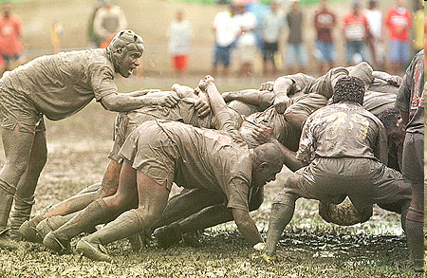
SCRUM

Slide 5
Scrum Overview
Scrum is an Agile process;
Used to manage complex projects since 1990;
Delivers business functionality in 30 days;
Business sets the priorities;
Teams self-organize to determine the best way to deliver the highest priority features.
Scalable to distributed, large, and long projects;
Extremely simple but very hard!

Slide 6
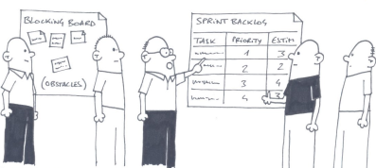
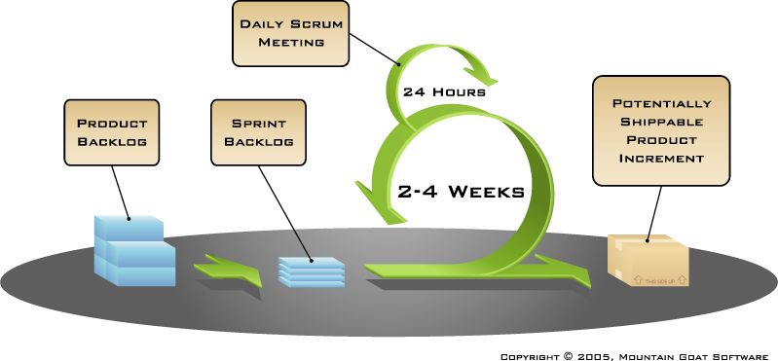

Scrum - framework
Timeboxing!
Sprint planning – “definition of Done”
Sprint review – “the demo”
Sprint retrospective
Daily scrum meeting
Scrum master
team
Product owner

Slide 7
Cross functional team Doesn’t mean everyone has to know everything
I can test, but I’m not so good at it.
Skills Needed to implement Top X backlog items
Product
Backlog
I don’t know CM at all. But I’m willing to learn!
Test
DB
Web
Java
Domain
CM
I’m good at Java!
Lisa
Joe
Fred
Jenny
David
Erik
I won’t even go near a database!
Notes:
7

Slide 8
Team
Seven (plus/minus two) members
Is cross-functional (Skills in testing, coding, architecture etc.)
Selects the Sprint goal and specifies work results
Has the right to do everything within the boundaries of the project guidelines to reach the Sprint goal
Organizes itself and its work
Demos work results to the Product Owner.

Slide 9
Scrum Master
Ensure that the team is fully functional and productive
Enable close cooperation across all roles and functions
Remove barriers
Shield the team from external interferences during the Sprint
Ensure that the process is followed, including issuing invitations to Daily Scrum, Sprint Review and Sprint Planning meetings.

Slide 10
Product Owner
Define the features of the product.
Decide on release date and content.
Be responsible for the profitability of the product (ROI).
Prioritize features according to market value.
Adjust features and priority every iteration, as needed
Accept or reject work results.

